Slide 1
Measuring the field distribution of a planar cavity
Yutong Zhao
May 6th 2019

Slide 2
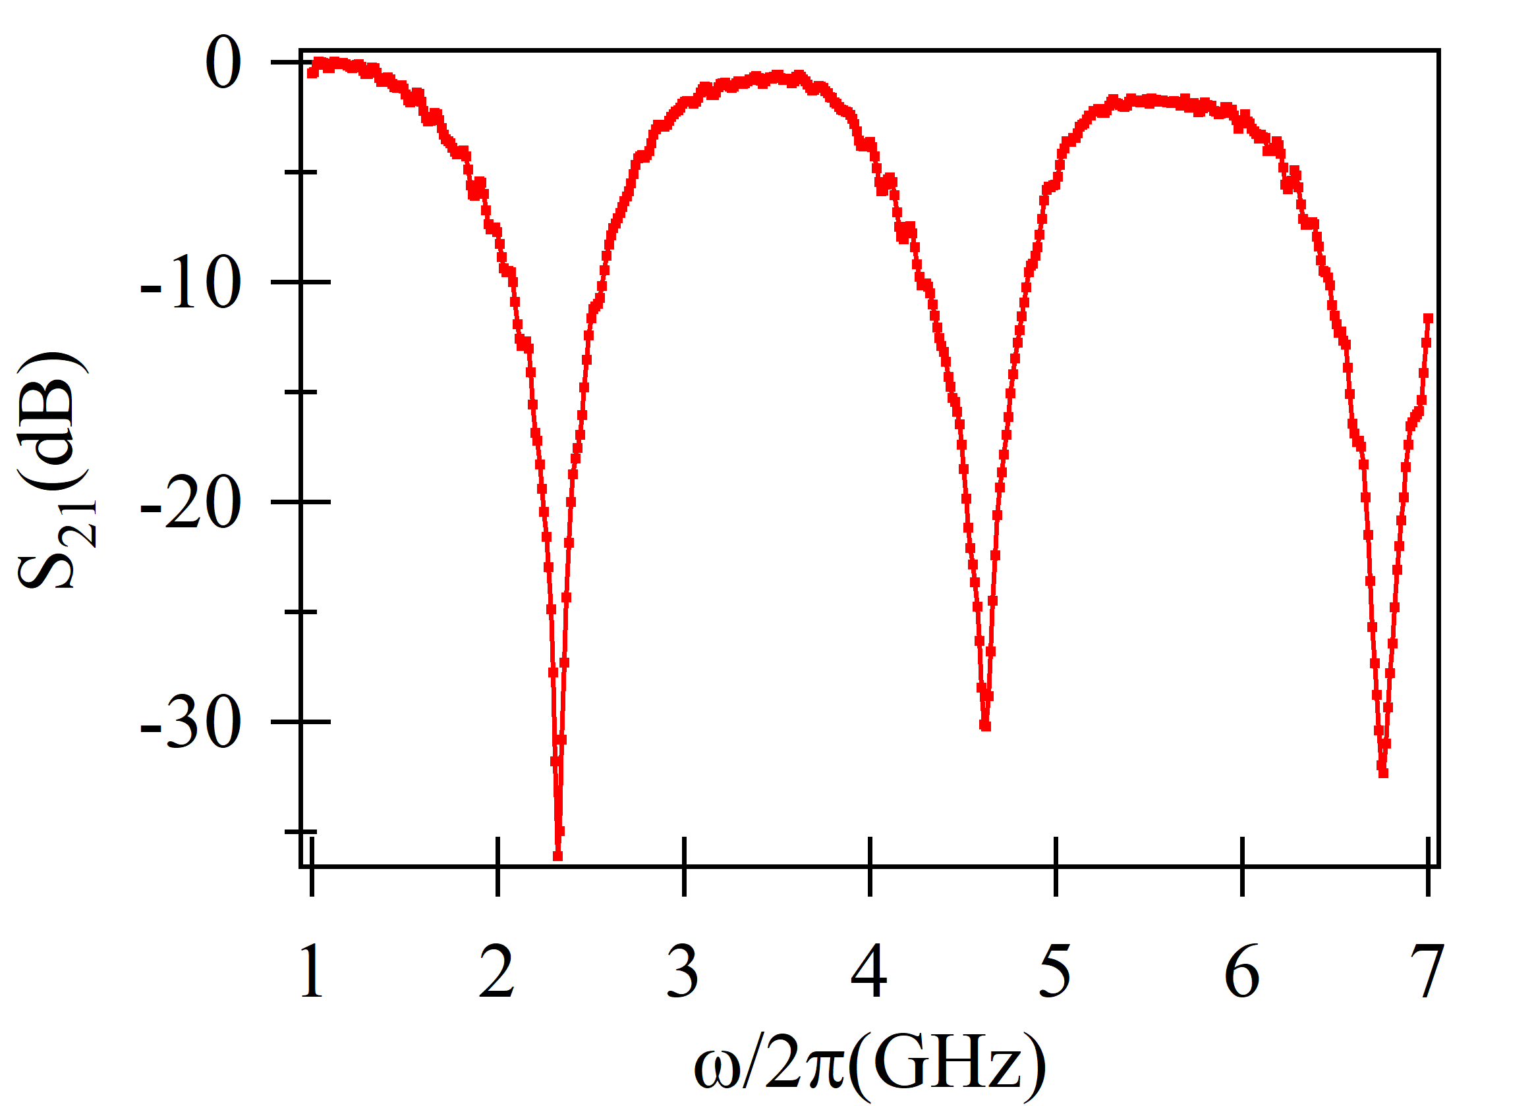
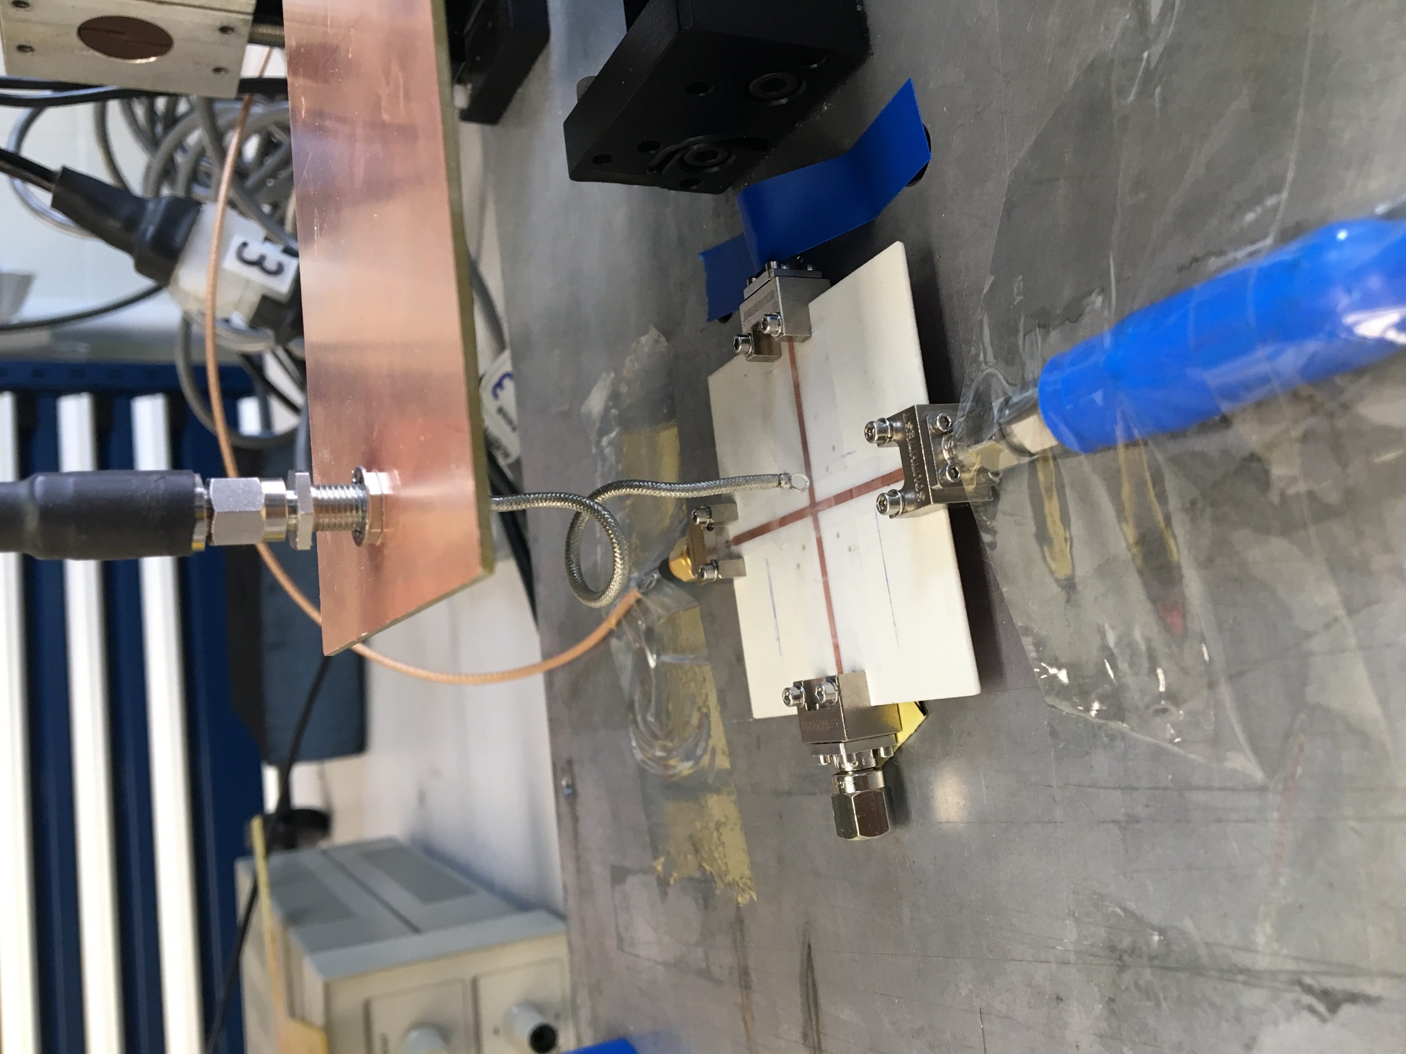
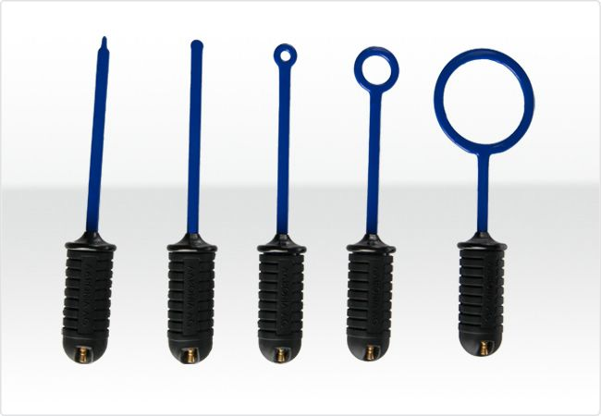
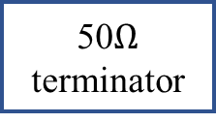
Experiment setup
Signal Analyzer
SG
Cavity
SA
50$Ω$ terminator
Transmission spectrum
3D stage
Magnetic field probe
Commercial
products
Signal generator
1st mode
2nd mode
3rd mode
Electric
Magnetic

Slide 3
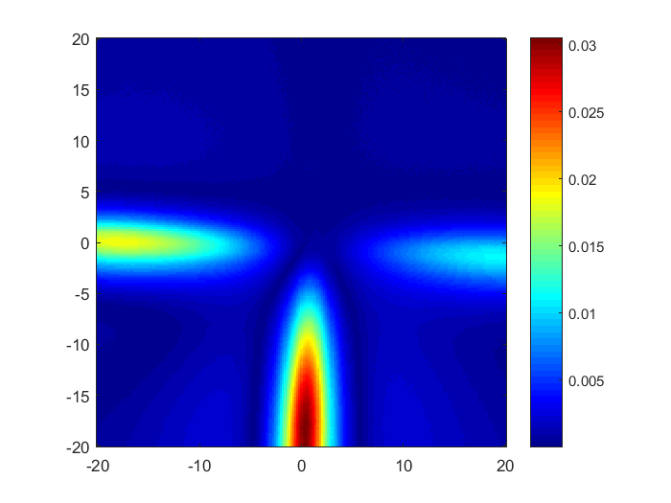
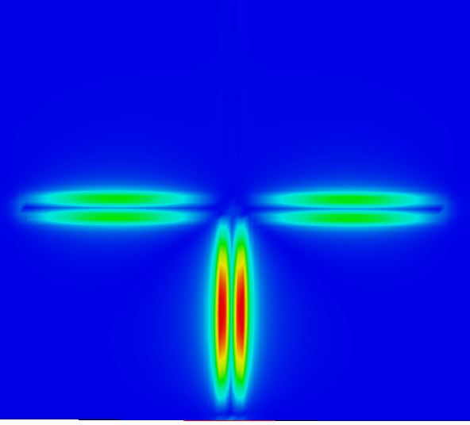


Electric field results
Measurement
CST simulation
$$y$$
$$x$$

Slide 4
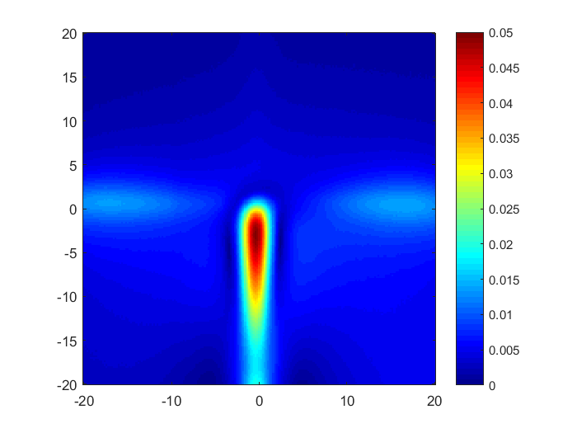
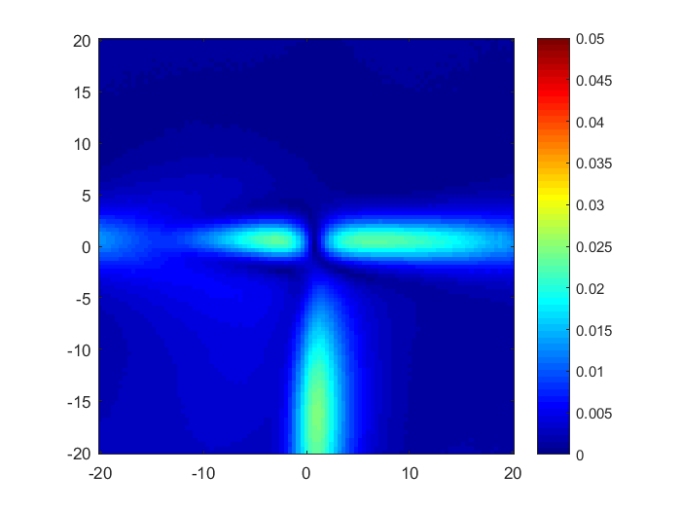
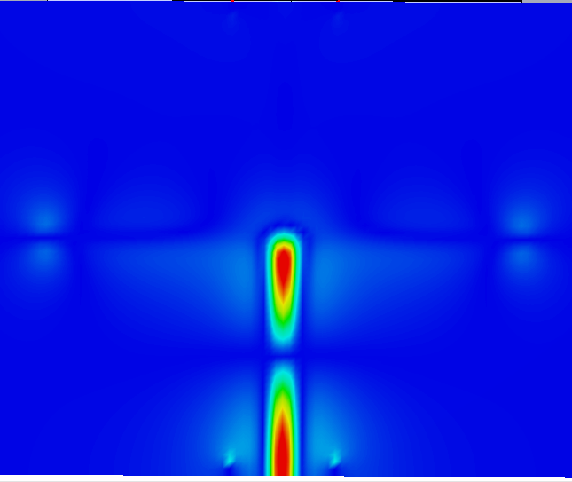
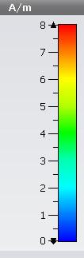
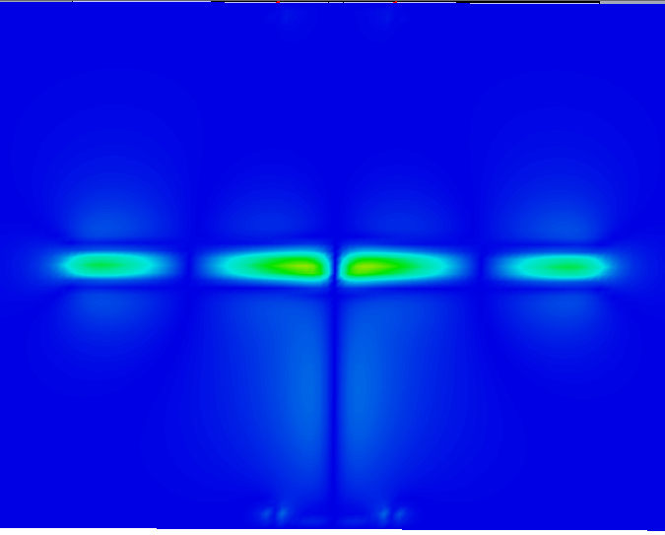
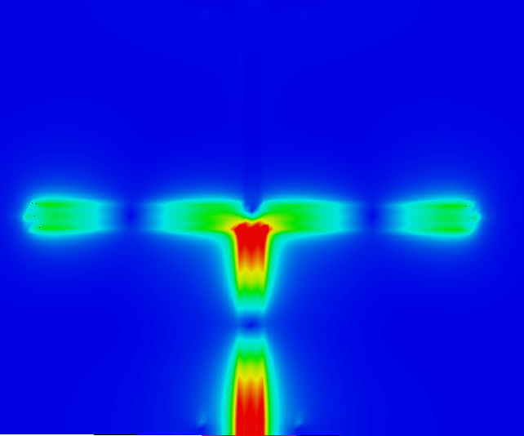


H_{x} field distribution
H_{y} field distribution
Measurement
Measurement
$$y$$
$$x$$
H_{abs} field distribution
CST simulation
CST simulation
CST simulation

Slide 5

Next step
Determine the standing wave using cavity perturbation method:
3D stage
Planar cavity
VNA
$$δf$$
Write the paper about the level attraction in metamaterials

Slide 6
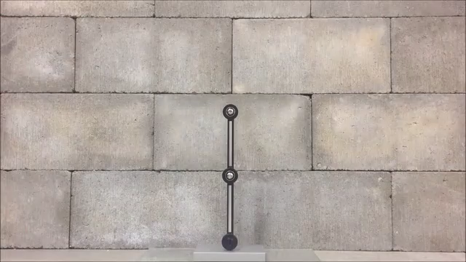
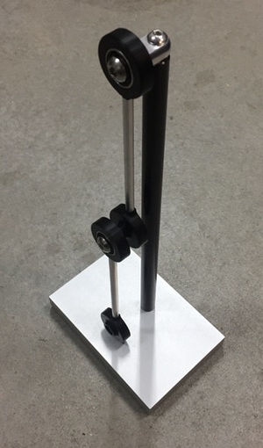
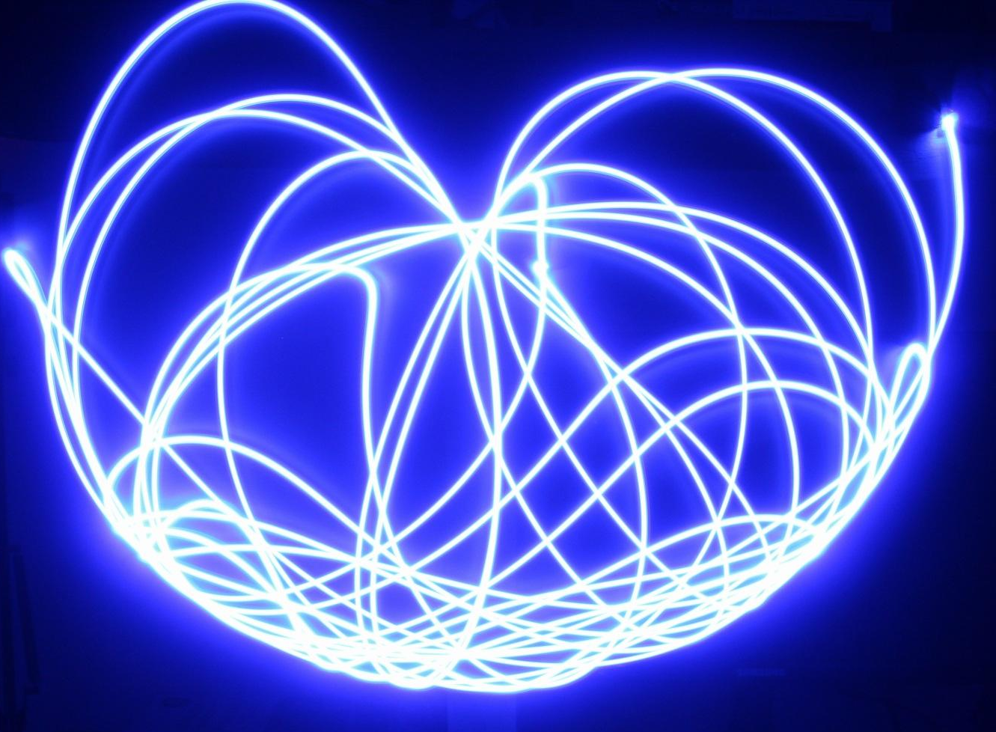
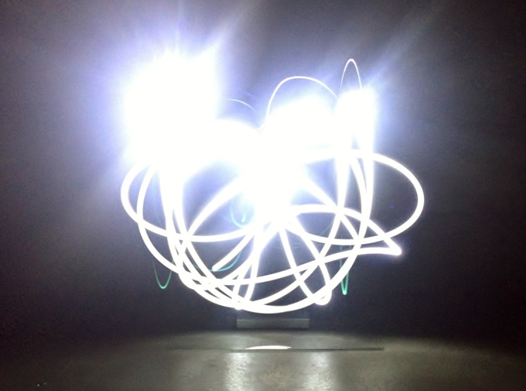
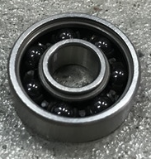
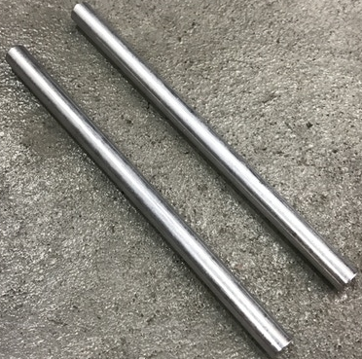
Further experiment: DIY coupled pendulum
Example on internet: double pendulum
Long exposure shows chaos
High performance bearing
Aluminum tube

